Slide 1

Site Provisioning Framework
Anders Dissing
CTO
Procurati

Slide 2



Sharing is caring…
Code samples
Guidance documentation
Monthly community calls
Case Studies
Themes
SharePoint add-ins
Microsoft Graph, Office 365 APIs etc.
Remote provisioning
Client side development
http://aka.ms/OfficeDevPnP

Slide 3
Agenda slide
Introducing the engine
How it works
Key Features
HOL

Slide 4
What is the PnP Provisioning Engine?
Open source community effort
Framework for easily doing Remote Provisioning
Part of the OfficeDev PnP Core Library
Object Oriented engine for easy and fast Remote Provisioning
Capabilities
Automated Remote Provisioning
Easy Site Template Generation/Extraction
Available in Microsoft .NET
There are PowerShell extensions for common tasks
Supports templating of sites and artifacts
Reusable, updatable (delta handling)

Slide 5
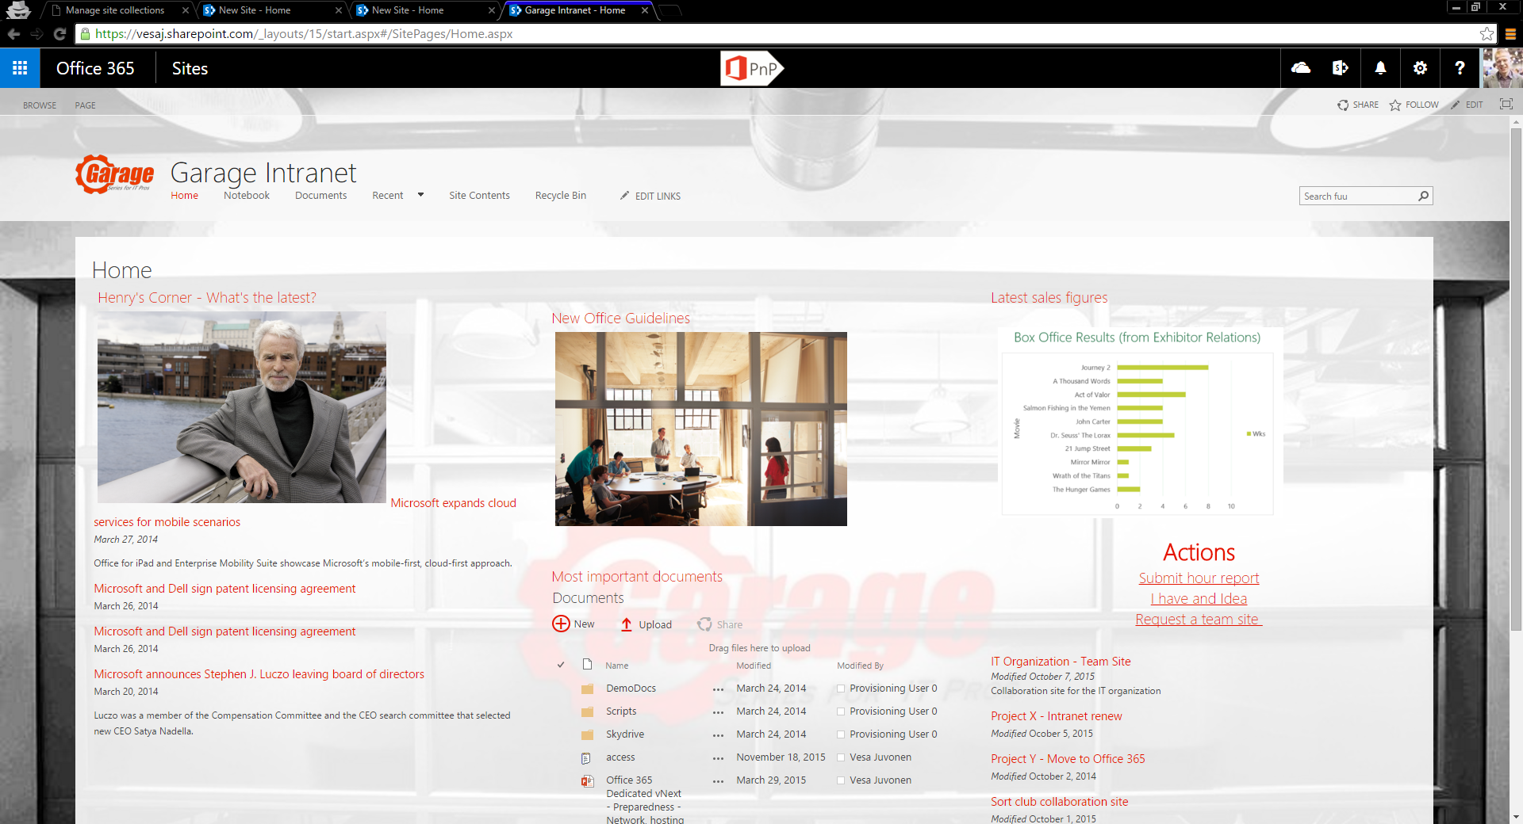
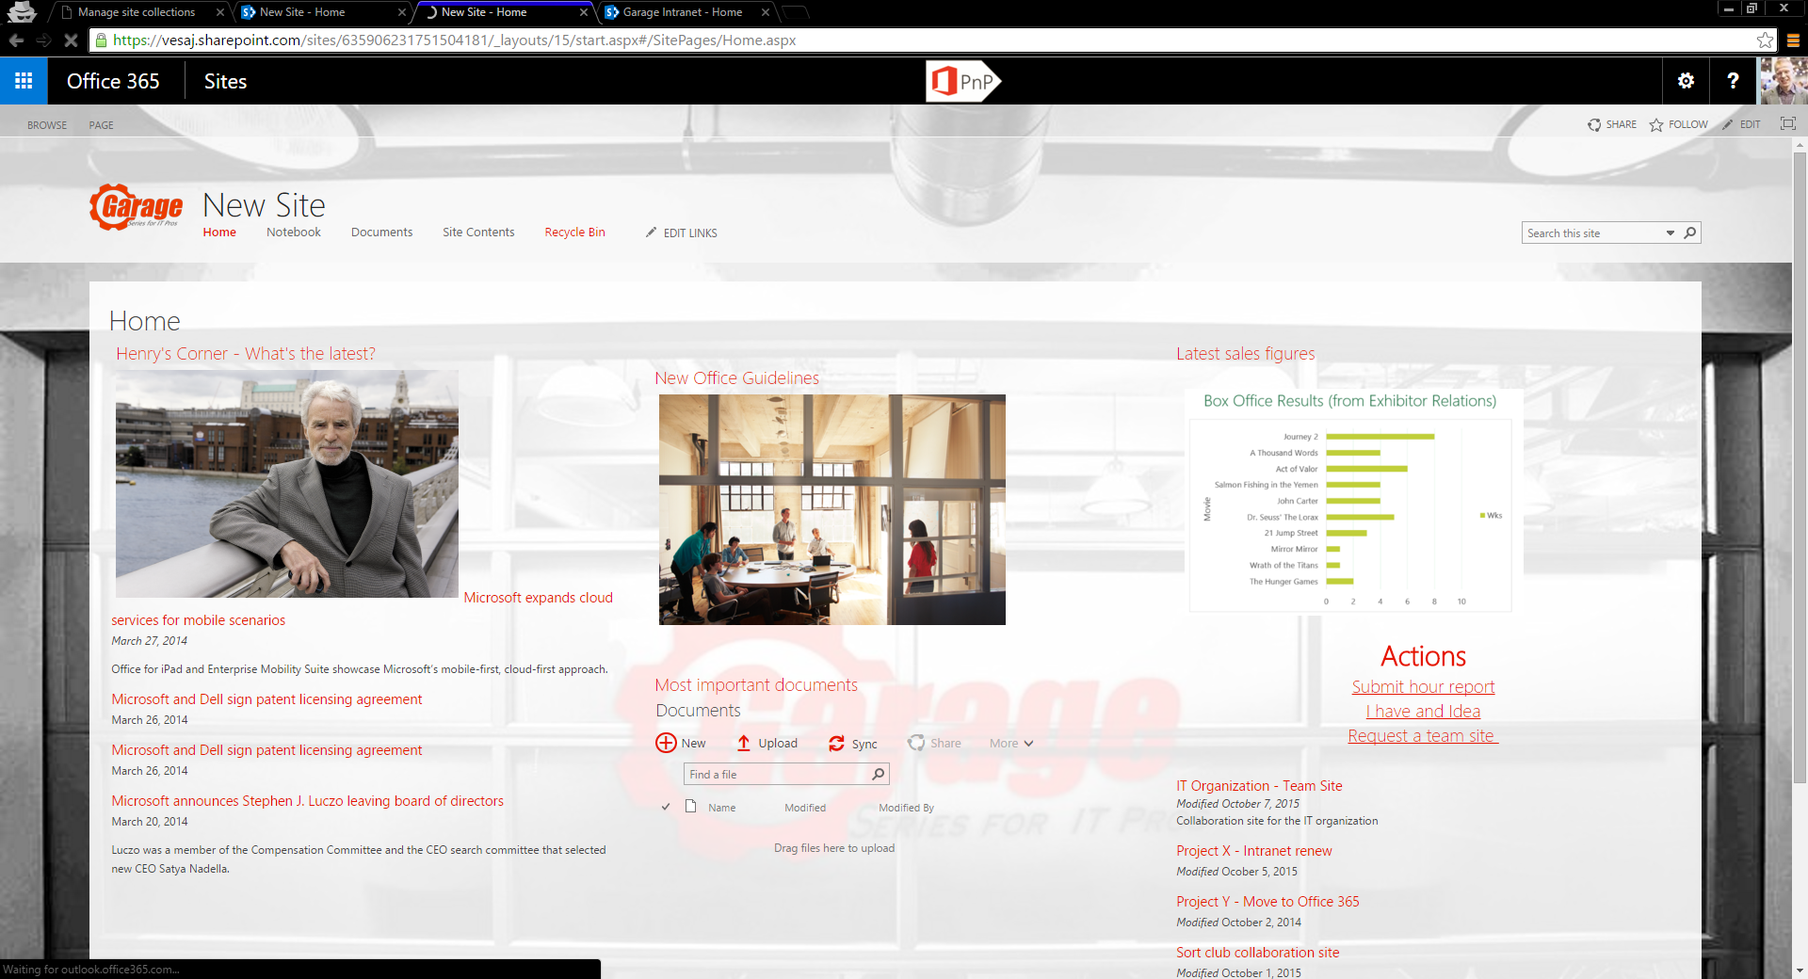
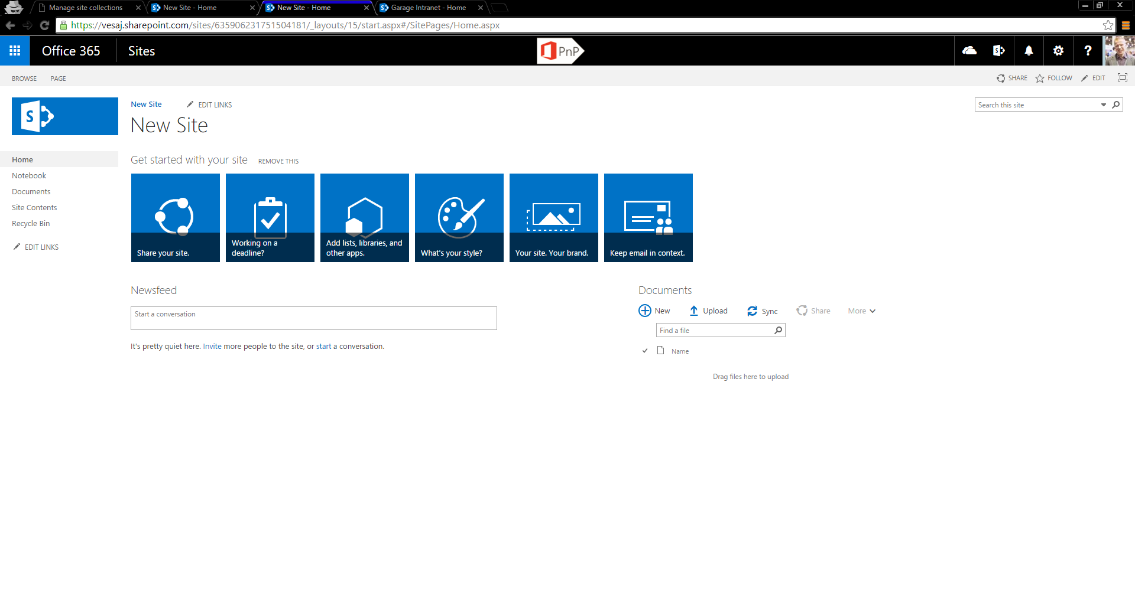
PnP Provisioning Engine – Export/Import
Template site
OOB site with needed configuration
Empty OOB site

Slide 6
PnP-Provisioning-Schema
Schema Review

Slide 7
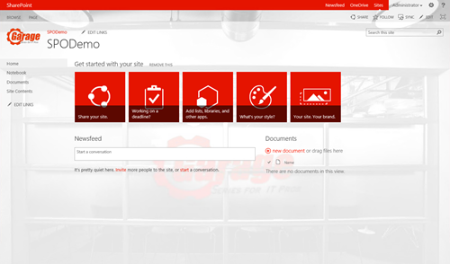
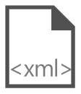
Site Provisioning Framework
C#
1
// Get template from existing site
template = ctx.Web.GetProvisioningTemplate();
Site A
XMLFileSystemTemplateProvider
2
// Save template using XML provider
XMLFileSystemTemplateProvider provider =
new XMLFileSystemTemplateProvider(@"c:\temp\", "");
string templateName = "template.xml";
provider.SaveAs(template, templateName);
// Load the saved model again
ProvisioningTemplate p2 =
provider.GetTemplate(templateName);
Connectors
XMLAzureStorageTemplateProvider
3
4
Site B
XMLSharePointTemplateProvider
// Apply template to existing site
ctxTarget.Web.ApplyProvisioningTemplate(template);
Notes:
Filesystem vil gemme ned på disk
Fil gemme filen i azure blob store
Vil gemme filen i et doc lib på sharepoint

Slide 8
Provisioning.Framework.Console
Code Review

Slide 9
Key Features
Export/Import of artifacts and configurations
No export of contents/files/pages*
Delta handling for on going maintenance
Template format(ter)-independent
XML Schema – community defined
JSON
Whatever else …
Extensibility Model
Notes:
Der bliver ikke taget filer, indhold eller sidder med. Dog forsiden bliver taget med
Selv Provisioning motoren og xml schemaet er adskildt og det er de fordi man selv kan lave sit eget skema
PnP teamet er også ved at en version som bygger på open-xml format hvor de kan havde nestede xml filer som udgøre template filen

Slide 10

PnP Remote Provisioning Engine in action
DEMO
Notes:
Show site model, extract template via PowerShell, apply template to fresh new target site, modify model, update target with delta handling.
Show code-based approach instead of PowerShell based approach
Show XML document of generated template

Slide 11
Delta Handling
We provide base templates to implement ‘delta handling’
Base templates are available for all supported O365 site definitions
Embedded in the engine
Useful to keep sites up to date with reference templates
Do not remove/delete anything
Just update/add
Notes:
PnP fjerne ikke noget, f.eks. Hvis der nu er blevet et felt mindre på en liste

Slide 12
PnP Provisioning Engine Main Features
SP2013, SP2016 and SPO
Delta templates
XML, JSON formatter
Site Columns
Content Types
Lists/Libraries Instances
Features (Site or Web)
Custom Actions (Site or Web)
Files/Pages (Wiki, WebPart)
Taxonomies
Composed Look
Site Policies
Web Settings
Regional Settings
UI Languages
Resource Files
Audit Settings
Workflows (SPD only)
Search Settings
Publishing (including Page Layouts)

Slide 13
PnP Remote Provisioning Engine in action
HOL
Notes:
Show site model, extract template via PowerShell, apply template to fresh new target site, modify model, update target with delta handling.
Show code-based approach instead of PowerShell based approach
Show XML document of generated template

Slide 14
It is a community project! Feel free to contribute with Issues, Pull Requests, Yammer threads

Slide 15
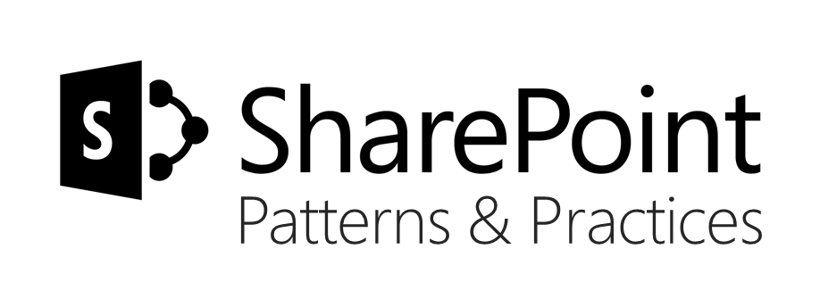







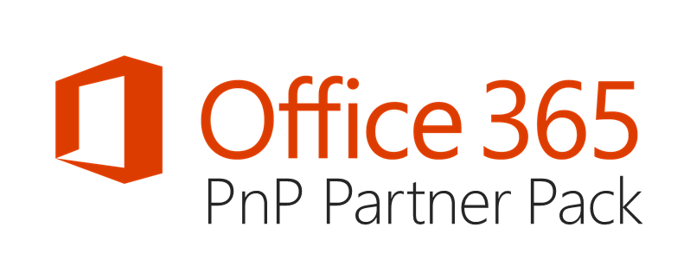

aka.ms/OfficeDevPnP
https://github.com/OfficeDev/PnP
https://github.com/OfficeDev/PnP-Sites-Core
https://github.com/OfficeDev/PnP-PowerShell
https://github.com/OfficeDev/PnP-Tools
https://github.com/OfficeDev/PnP-Guidance
https://github.com/OfficeDev/PnP-Transformation
https://github.com/OfficeDev/PnP-OfficeAddIns
https://github.com/OfficeDev/PnP-Provisioning-Schema
https://aka.ms/OfficeDevPnPVideos
https://aka.ms/OfficeDevPnPMSDN
https://aka.ms/OfficeDevPnPYammer
https://docs.com/OfficeDevPnP
@OfficeDevPnP
https://aka.ms/OfficeDevPnPCall
https://aka.ms/OfficeDevPnPPartnerPack

Slide 16
Q&A

